Slide 1

Cyclistic Bike Share
A look into how different customers use the bike share service
Joshua Ssemwanga
Notes:
This slide contains the editable pieces that were used to build infographic sample
Icons – Eye, PC

Slide 2

CYCLISTIC BIKE SHARE
About
Cyclistic is a bike-share program that started in 2016, featuring more than 5,800 bicycles and 600 docking stations across Chicago. The program has two types of customers, casual riders and members. Casual riders are those who purchase a day pass or a single ride ticket, riders who have an annual membership to the service are considered Cyclistic members.
The Task
To analyze ride patterns in 2022
The Goal
To better understand how casual riders and members use the service differently.

Slide 3
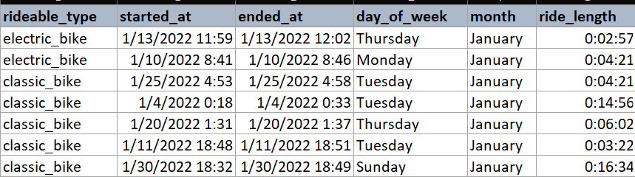
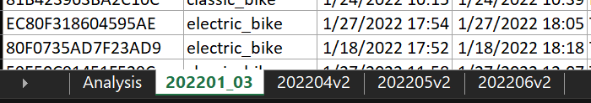
Data Process
For this project, the datasets used are available here.
Cleaned and Processed each month of ride data using Microsoft Excel
Additional data
Included 3 new columns: day_of_week, month and ride_length. To help with analysis
Joined together the smaller datasets (January through March) datasets using R.
Brought together all the months of data into a single spreadsheet workbook.
January - March
April
May
June

Slide 4
What Do We Want To Know?
To investigate the difference in casual riders and member riders we can find out:
How much time is each customer type spending on a ride?
What days are each customer type typically riding?
What months are each customer type typically riding?
What bikes do customers prefer?

Slide 5
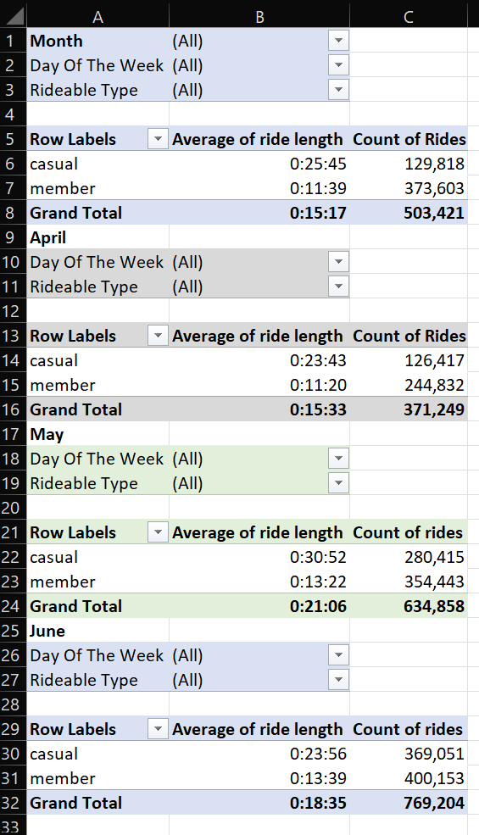
What Do We Want To Know?
To analyze these questions, pivot tables were made. Each table summarizing a month of data.
Month
Filter January, February and March
Day of the week
Filter for the days of the week
Rideable Type
Filter for classic or electric bikes
Row Label
Casual and member summaries

Slide 6
The Data Story
How much time is each customer type spending on a ride?
 | January | February | March | April | May | June
Casual | 0:18:15 | 0:20:19 | 0:28:36 | 0:23:43 | 0:30:52 | 0:23:56
Member | 0:11:38 | 0:11:02 | 0:11:57 | 0:11:20 | 0:13:22 | 0:13:39
The Story
Member riders are more consistent with their ride lengths. Suggesting that members typically use their bikes to ride the same routes, such as to work or to school. Casual riders take longer routes around the city

Slide 7
The Data Story
What days are each customer type typically riding?
 | Monday | Tuesday | Wednesday | Thursday | Friday | Saturday | Sunday
Casual | 117,820 | 103,777 | 102,462 | 124,602 | 117,269 | 175,915 | 163,856
Member | 203,981 | 219,381 | 209,632 | 221,546 | 179,399 | 173,051 | 166,041
The Story
Member riders are taking more trips during the work week, almost twice as much as casual riders. Casual riders are more likely to take trips during the weekend, with Saturdays being the busiest day.

Slide 8
The Data Story
What months are each customer type typically riding?
 | January | February | March | April | May | June
Casual | 18,520 | 21,416 | 89,882 | 126,417 | 280,415 | 369,051
Member | 85,250 | 94,193 | 194,160 | 244,832 | 354,443 | 400,153
The Story
Member riders are using the service more often throughout the year Casual riders are riding almost twice as much during May and June than they are in January through March.

Slide 9
The Data Story
What bikes do customers prefer?
The Story
Member riders take more trips with the classic bikes. Casual riders only slightly prefer electric bikes
 | Classic Bikes | Electric Bikes
Casual | 394,082 | 431,774
Member | 752,256 | 620,775
Total | 1,146,338 | 1,052,549
9

Slide 10
Cyclistic members:
Are taking more trips than casual riders every month (60% of all trips)
Trip lengths are more consistent (11-14 minutes on average)
Take more trips from Monday to Friday, than Saturday and Sunday. (35000 more trips on average)
Casual Riders:
Are taking more trips during May and June
Trip lengths tend to vary depending on the month
Take more trips on Saturday and Sunday than Monday to Friday
Prefer electric bikes

Slide 11
Recommendations
Cyclistic should target promotion towards potential customers who are working or going to school during the week.
Promotion should be run during the warmer months when the service is being used a lot by casual riders
Cyclistic could also promote more use of electric bikes as they are preferred among casual riders.

